Slide 1



Trichromatic Online Matching in Real-time Spatial Crowdsourcing
Tianshu Song ¹, Yongxin Tong ¹, Libin Wang ¹, Jieying She ², Bin Yao ³, Lei Chen ², Ke Xu ¹ ¹ Beihang University ² The Hong Kong University of Science and Technology ³ Shanghai Jiao Tong University
Notes:
Good afternoon everyone. I am Tianshu Song from Beihang University. Today I’ll present our work Trichromatic Online Matching in Real-time Spatial Crowdsourcing. This is a collaborative work with Yongxin, Libin and Ke from Beihang University, Jieying and Lei from HKUST and Bin from Shanghai Jiao Tong University.

Slide 2
Outline
Background and Motivation
Problem Statement
Our Solutions
Experiments
Conclusion
Notes:
This is the outline

Slide 3
Outline
Background and Motivation
Problem Statement
Our Solutions
Experiments
Conclusion
Notes:
I will first introduce the background and the motivation

Slide 4

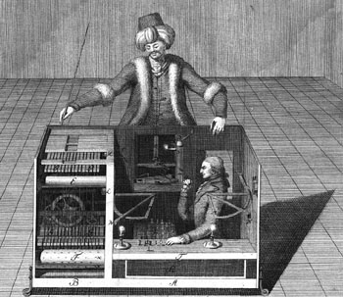


Background
Crowdsourcing
The outsourcing of tasks traditionally performed by an employee to an “undefined, generally large group of people in the form of an open call”
Traditional Crowdsourcing Applications
Question/Answer Type of Crowdsourcing
General Crowdsourcing
AMT
Notes:
I think you have been pretty familiar with crowdsourcing.
Crowdsourcing refers to the outsourcing of tasks traditionally performed by an employee to an “undefined, generally large group of people in the form of an open call [19]”.
The earliest cr platforms include some Q&A platforms such as Yahoo answer, stackoverflow and quora.
Recently, some famous traditional web-based crowdsourcing platforms become popular, such as AMT, oDesk, CrowdFlower.

Slide 5
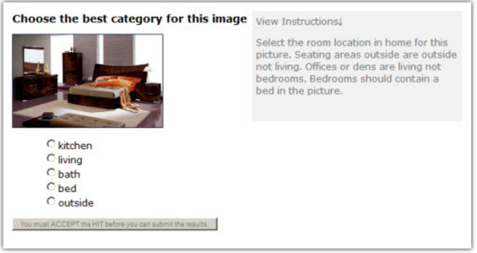
Traditional Crowdsourcing
Tasks are performed in the Internet world
Notes:
In recent years, spatial crowdsourcing platforms have been more and more popular with the development of smartphone and mobile internet.
In traditional crowdsourcing, the crowd workers just perform tasks on the websites

Slide 6
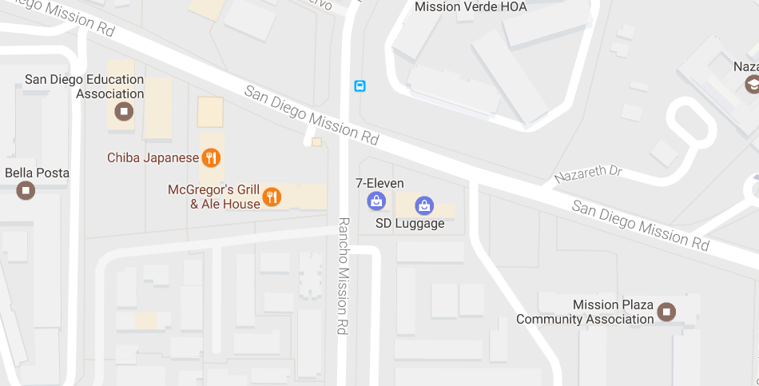

Spatial Crowdsourcing
Traditional Crowdsourcing v.s. Spatial Crowdsourcing
Traditional: Tasks performed in the Internet world
Spatial: Tasks are performed in the real world
A task: queue up for me
A worker
Notes:
In spatial crowdsourcing, works have to move to a specific location and perform the tasks, and the platforms often help assign offline spatial tasks to online workers.
In fact, many sc platforms of O2O applications are used in our daily life.

Slide 7
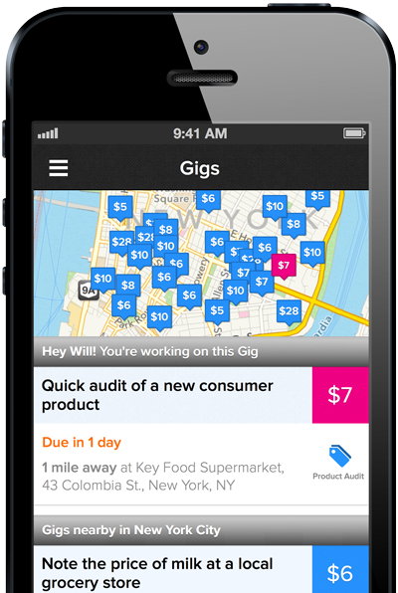






Spatial Crowdsourcing Applications
Notes:
Here are some famous examples of spatial crowdsourcing platforms.
These two are real-time taxi-calling services, uber and the Chinese uber “DIDI Chuxing”.
This one is gigwalk, where users send out tasks to nearby crowd workers waiting for tasks. We can see on the right that the tasks are tagged at different locations and have different prices. Other similar examples include fieldagent.
Besides, Waze encourages people to share live traffic report
Finally, there are also some emerging applications such as Nanguache, where more than 3 types of objects are involved, which will be introduced in detail later.

Slide 8
Spatial Crowdsourcing
Spatial Crowdsourcing Platforms
Help assign offline spatial tasks to online crowd workers
e.g. Offline-to-Online (O2O) applications
Core Challenges
Task Allocation/Assignment
Quality Control
Privacy Protection
……
Task allocation/assignment is the most important !
Notes:
Particularly, for spatial crowdsourcing platforms, the core challenges include task allocation or assignment, quality control, privacy protection, etc.
Among them, the most important one is task allocation. Thus, we only focus on task assignment in this talk

Slide 9

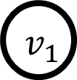

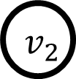


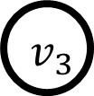

Existing Research
Static Scenarios: considered as the offline maximum weighted bipartite graph matching problem.
A crowd worker
7
A spatial task
5
3
Weight: the utility score between a task and a worker.
11
9
7
1
6
2
Finding a matching to maximize the total utility
L. Kazemi et al. Geocrowd: enabling query answering with spatial crowdsourcing. In GIS 2012.
H. To et al. A server-assigned spatial crowdsourcing framework. In TASA 2015.
Notes:
The existing research can be divided into two part: static & dynamic
Early researches on task allocation usually regard the assignment problem as the classical maximum weighted bipartite graph matching problem.
Here is an example. The nodes on the left represent the spatial tasks, and the ones on the right represent the crowd workers.
Each edge between a task and a worker has a weight, which is the utility score obtained when the worker successfully completes the task. The utility score can be gained by any utility function.
Hence, the task assignment problem in static scenarios is to find a matching so that to maximize the total utility. (动画)

Slide 10
Existing Research
Dynamic Scenarios : considered as the online maximum weighted bipartite graph matching problem.
Y. Tong et al. Online Mobile Micro-Task Allocation in Spatial Crowdsourcing. In ICDE 2016.
Notes:
Besides the static scenarios, recent research considers the dynamic characteristic of many spatial crowdsourcing applications, where the tasks and the workers appear on the platform dynamically, and need to be responded immediately so that they will not wait too long, existing works also consider the task assignment problem as the online maximum weighted bipartite graph matching problem.

Slide 11
Offline v.s. Online
7
5
3
11
9
7
1
6
2
The offline optimal cost is 20
Offline Scenario
Notes:
Hungarian algorithm

Slide 12
Offline v.s. Online
7
5
3
11
9
7
1
6
2
The offline optimal cost is 20
Offline Scenario
Online Scenario
Notes:
Suppose in the online scenario, a crowd worker u3 arrives first.

Slide 13
Offline v.s. Online
7
5
3
3
11
9
7
1
Full bipartite graph cannot be known.
The new arrival object needs to be immediately assigned based on partial information.
6
2
The offline optimal cost is 20
Offline Scenario
Online Scenario
Notes:
Then a task v1 arrives afterwards. Until now, only v1 and u3 are on the platform.
Although we cannot know the full bipartite graph as in the offline scenario on the left, we have to make assignment based on such partial graph.

Slide 14
Offline v.s. Online
7
5
3
3
11
9
7
1
Full bipartite graph cannot be known.
The new arrival object needs to be immediately assigned based on partial information.
6
2
The offline optimal cost is 20
Offline Scenario
Online Scenario
Notes:
Therefore, v1 can only be assigned to u3.

Slide 15
Offline v.s. Online
7
5
3
3
11
9
7
1
6
2
The offline optimal cost is 20
Offline Scenario
Online Scenario
Notes:
After that, another task v2 appears.
Since there is no edge between v2 and u3, we do nothing.

Slide 16
Offline v.s. Online
7
5
3
3
11
9
9
7
1
1
6
2
The offline optimal cost is 20
Offline Scenario
Online Scenario
Notes:
Then u4 arrives afterwards.
Though assigning v1 to u4 will result in larger utility, v1 has been assigned to u3 so we can only assign v2 to u4.

Slide 17
Offline v.s. Online
7
7
5
5
3
3
11
9
9
7
1
1
6
2
The offline optimal cost is 20
Offline Scenario
Online Scenario
Notes:
Then workers u1 and u2 arrive, but no task can be assigned to them as v1 has been unavailable.

Slide 18
Offline v.s. Online
7
7
5
5
3
3
11
9
9
7
1
1
6
6
2
The offline optimal cost is 20
Offline Scenario
Online Scenario
Notes:
Then v3 arrives and cannot be assigned to u4 since u4 has been allocated to the task v2.

Slide 19
Offline v.s. Online
7
7
5
5
3
3
11
11
The matching of the online scenarios will be always no better than that of the offline scenarios
9
7
1
7
1
6
6
2
2
The offline optimal cost is 20
Offline Scenario
Online Scenario
Notes:
Finally, worker u5 arrives and is allocated to task v3. As a result, this online matching only has total utility of 6.
Therefore, the online scenario is called a two-sided online bipartite matching, where two-side means that both tasks and workers appear dynamically.

Slide 20

Motivation
More than two types of objects are involved and need to be matched
Sports trainers, sports facilities and users
Hairstylists, salon and customers
Notes:
Although the existing works model the problem as the online/offline bipartite graph matching, there are some emerging applications where … such as …
Our work the is first to consider both the dynamic characteristics and the matching involving three types of objects

Slide 21
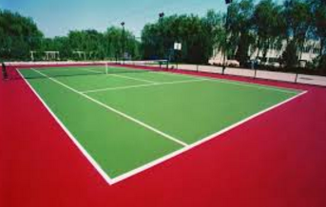
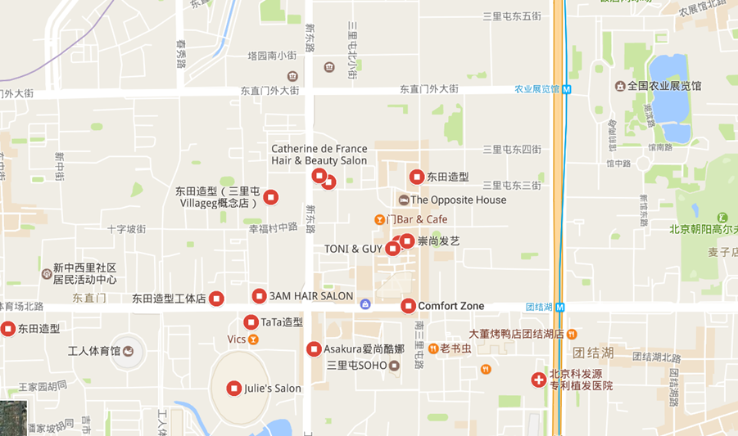
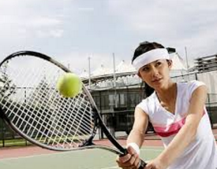

Motivation
I can offer a tennis court
I want to play tennis
I can help improve your skills
Notes:
加一个网球的例子

Slide 22

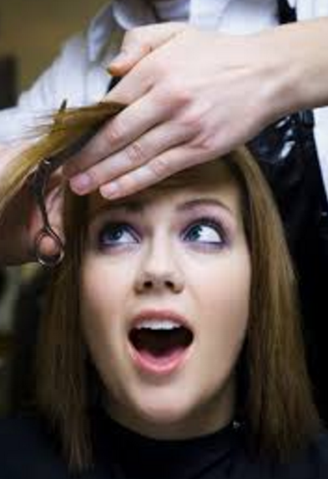


Motivation
I can offer a position for haircut
Tasks, workers and available positions appear on the platform dynamically, and the platform needs to assign them!
I want to have a haircut
Device, security or privacy issues
I can provide haircut service
The third-part workplaces are indispensable!
Notes:
加一个网球的例子

Slide 23
Motivation
Why the existing bipartite matching solutions cannot work for more than two types of objects
First, the existing solutions for offline bipartite matching cannot work here as our problem is a dynamic/online one;
Second, the state-of-the-art solution is in the ICDE’2016 of Y. Tong et. al, where the Hungarian algorithm for the partial bipartite graph is used. However, the three dimensional matching (3DM) problem is NP-hard. Thus, the state-of-the-art solution for online bipartite graph matching cannot work here.
Y. Tong et al. Online Mobile Micro-Task Allocation in Spatial Crowdsourcing. In ICDE 2016.
Notes:
Although the existing works model the problem as the online/offline bipartite graph matching, there are some emerging applications where … such as …
Our work the is first to consider both the dynamic characteristics and the matching involving three types of objects

Slide 24
Outline
Background and Motivation
Problem Statement
Our Solutions
Experiments
Conclusion
Notes:
Motivated the above examples, We then formally define our problem.

Slide 25
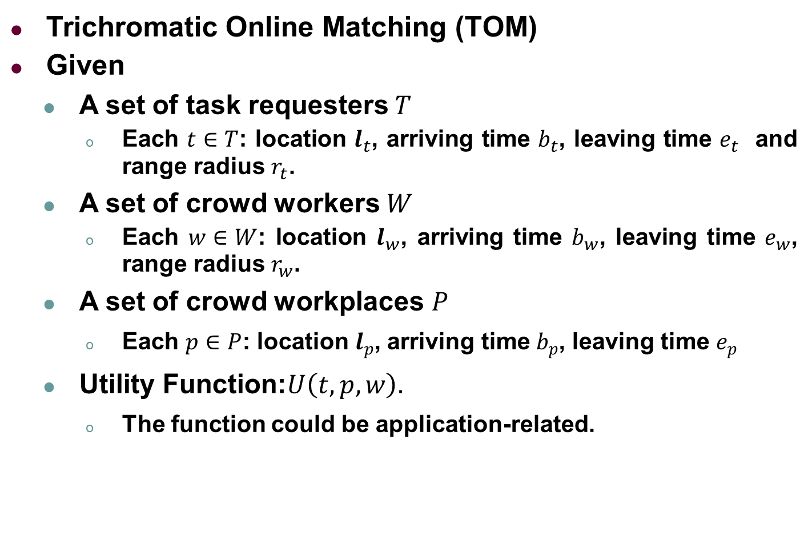
Problem Statement
Trichromatic Online Matching (TOM)
Given
A set of task requesters $T$
Each $t∈T$: location $l_{t}$, arriving time $b_{t}$, leaving time $e_{t}$ and range radius $r_{t}$.
A set of crowd workers $W$
Each $w∈W$: location $l_{w}$, arriving time $b_{w}$, leaving time $e_{w}$, range radius $r_{w}$.
A set of crowd workplaces $P$
Each $p∈P$: location $l_{p}$, arriving time $b_{p}$, leaving time $e_{p}$
Utility Function:$U\left(t,p,w\right).$
The function could be application-related.
Notes:
Particularly, we study the Trichromatic Online Matching .
We are given a set of spatial tasks, each with …
We are also given a set of workers, each with ...
The utility of a triple is calculated by the utility function U

Slide 26
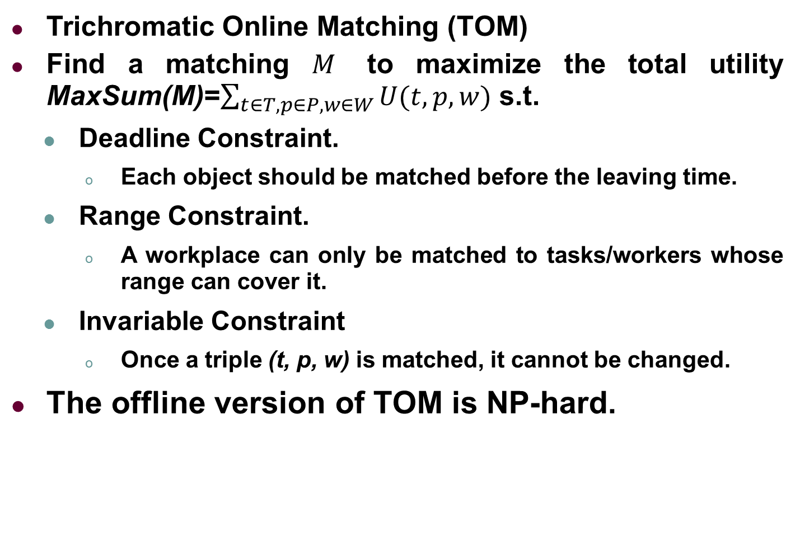
Problem Statement
Trichromatic Online Matching (TOM)
Find a matching $M$ to maximize the total utility MaxSum(M)=$\sum_{t∈T,p∈P,w∈W}{U(t,p,w)}$ s.t.
Deadline Constraint.
Each object should be matched before the leaving time.
Range Constraint.
A workplace can only be matched to tasks/workers whose range can cover it.
Invariable Constraint
Once a triple (t, p, w) is matched, it cannot be changed.
The offline version of TOM is NP-hard.
Notes:
Todo: 详细解释
Our goal is to find an allocation to maximize....
Particularly, the invariable [ɪnˈveriəb(ə)l] constraint means that the allocation between a task and a worker cannot be revoked once it is made.

Slide 27
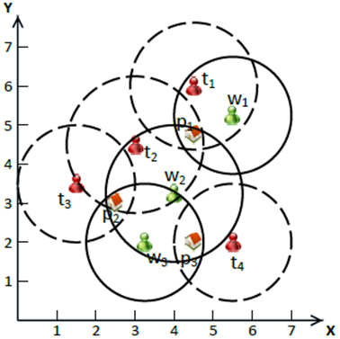
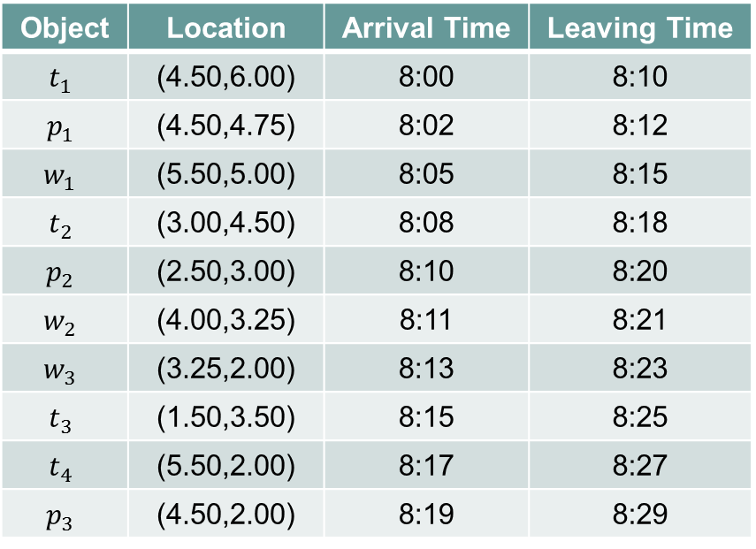
Problem Statement
Running example
Object | Location | Arrival Time | Leaving Time
$$t_{1}$$ | (4.50,6.00) | 8:00 | 8:10
$$p_{1}$$ | (4.50,4.75) | 8:02 | 8:12
$$w_{1}$$ | (5.50,5.00) | 8:05 | 8:15
$$t_{2}$$ | (3.00,4.50) | 8:08 | 8:18
$$p_{2}$$ | (2.50,3.00) | 8:10 | 8:20
$$w_{2}$$ | (4.00,3.25) | 8:11 | 8:21
$$w_{3}$$ | (3.25,2.00) | 8:13 | 8:23
$$t_{3}$$ | (1.50,3.50) | 8:15 | 8:25
$$t_{4}$$ | (5.50,2.00) | 8:17 | 8:27
$$p_{3}$$ | (4.50,2.00) | 8:19 | 8:29
Notes:
How to

Slide 28
Problem Statement
Running example
p1 is in the range of t1, thus there is an edge
A match should have three objects and two edges
Notes:
字体加大加粗

Slide 29
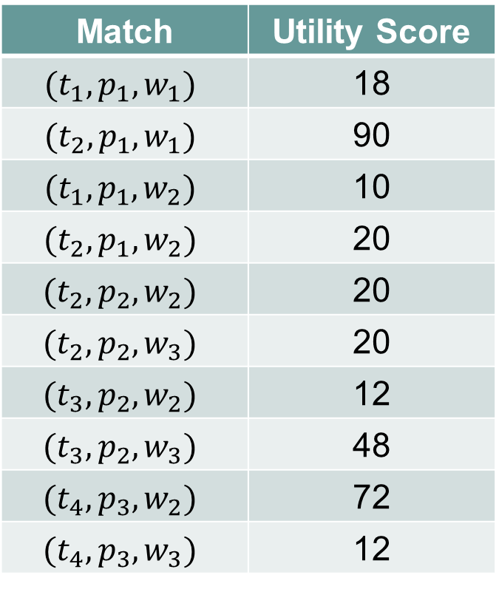
Problem Statement
Running example
Match | Utility Score
$$(t_{1},p_{1},w_{1})$$ | 18
$$(t_{2},p_{1},w_{1})$$ | 90
$$(t_{1},p_{1},w_{2})$$ | 10
$$(t_{2},p_{1},w_{2})$$ | 20
$$(t_{2},p_{2},w_{2})$$ | 20
$$(t_{2},p_{2},w_{3})$$ | 20
$$(t_{3},p_{2},w_{2})$$ | 12
$$(t_{3},p_{2},w_{3})$$ | 48
$$(t_{4},p_{3},w_{2})$$ | 72
$$(t_{4},p_{3},w_{3})$$ | 12
Notes:
How to

Slide 30
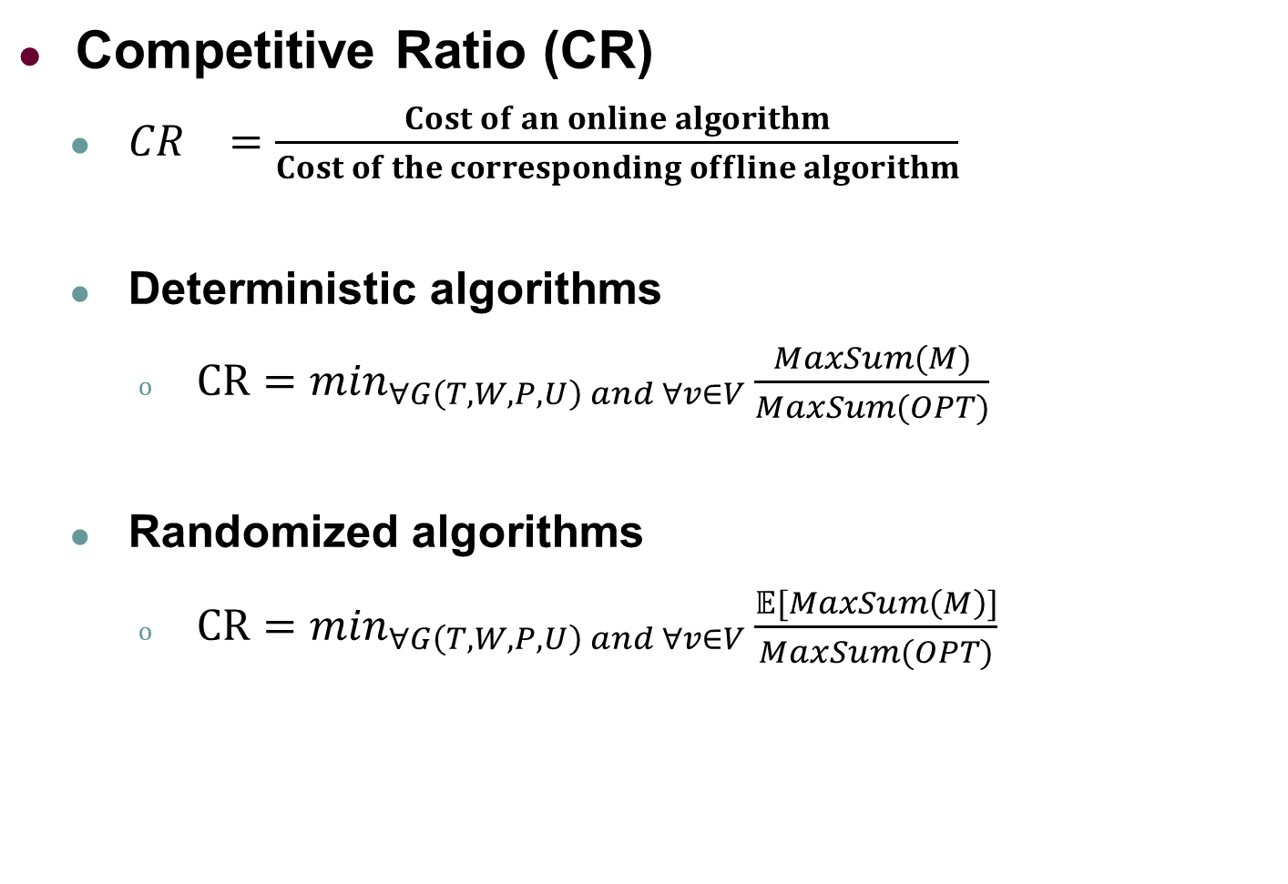
Evaluation for Online Algorithms
Competitive Ratio (CR)
${CR}_{}=\frac{Cost of an online algorithm}{Cost of the corresponding offline algorithm}$
Deterministic algorithms
$CR=\min_{∀G\left(T,W,P,U\right) and ∀v∈V}\frac{MaxSum(M)}{MaxSum(OPT)}$
Randomized algorithms
$CR=\min_{∀G\left(T,W,P,U\right) and ∀v∈V}\frac{𝔼[MaxSum\left(M\right)]}{MaxSum(OPT)}$
The worst trichromatic graph
The worst arrival order
The expected performance is compared.
Notes:
For online algorithms, competitive ratio is used to evaluate their performance.
Competitive ratio compares the performance of an online algorithm to that of an optimal offline algorithm which has full information in advance.
If the online algorithm is randomized, the expected performance will be compared.

Slide 31
Outline
Background and Motivation
Problem Statement
Our Solutions
Baseline: Greedy
Threshold-Based: Basic, Adaptive
Experiments
Conclusion
Notes:
We next present our solutions. First, Second

Slide 32
Greedy Algorithm
Basic idea
Match all triples when it is possible.
When multi triples can be matched, match the one with the maximal utility.
Notes:
The first is a greedy algorithm, which matches all triples when it is possible.

Slide 33

Greedy Algorithm
Basic idea
Match all triples when it is possible.
Match | Utility Score
$$t_{1}$$
Notes:
Here is a running example.

Slide 34

Greedy Algorithm
Basic idea
Match all triples when it is possible.
Match | Utility Score
$$t_{1}$$
$$p_{1}$$
Notes:
Cannot match as only two

Slide 35
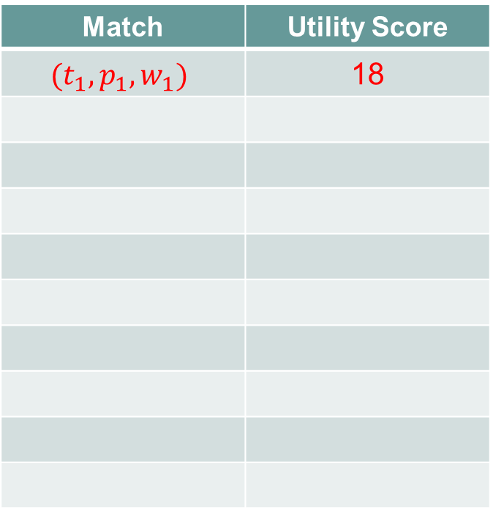

Greedy Algorithm
Basic idea
Match all triples when it is possible.
Match | Utility Score
$$(t_{1},p_{1},w_{1})$$ | 18
$$t_{1}$$
$$p_{1}$$
$$w_{1}$$
Notes:
加大加粗

Slide 36


Greedy Algorithm
Basic idea
Match all triples when it is possible.
Match | Utility Score
$$(t_{1},p_{1},w_{1})$$ | 18
$$(t_{2},p_{1},w_{1})$$ | 90
$$t_{1}$$
$$p_{1}$$
$$w_{1}$$
$$t_{2}$$
Although the utility of (t2, p1, w1) is much larger than that of (t1, p1, w1), we cannot invoke the matching that has been made because of the invariable constraint.
Notes:
When t2 comes, no triple can be matched

Slide 37

Greedy Algorithm
Basic idea
Match all triples when it is possible.
Match | Utility Score
$$(t_{1},p_{1},w_{1})$$ | 18
$$(t_{2},p_{1},w_{1})$$ | 90
$$t_{1}$$
$$p_{1}$$
$$w_{1}$$
$$t_{2}$$
$$p_{2}$$
No triple
Notes:
When t2 comes, no triple can be matched

Slide 38
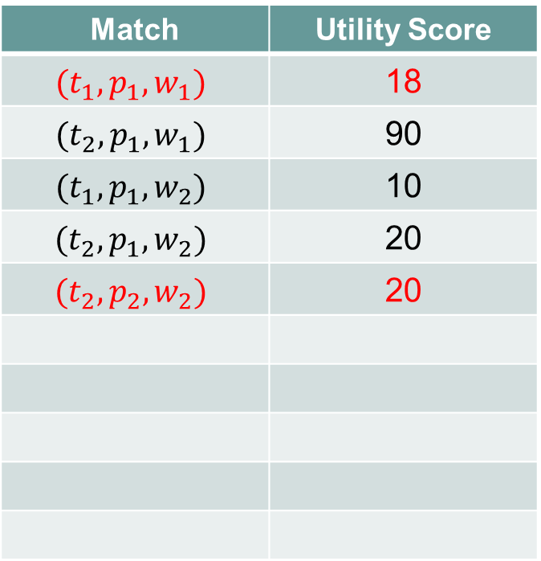

Greedy Algorithm
Basic idea
Match all triples when it is possible.
Match | Utility Score
$$(t_{1},p_{1},w_{1})$$ | 18
$$(t_{2},p_{1},w_{1})$$ | 90
$$(t_{1},p_{1},w_{2})$$ | 10
$$(t_{2},p_{1},w_{2})$$ | 20
$$(t_{2},p_{2},w_{2})$$ | 20
$$t_{1}$$
$$p_{1}$$
$$w_{1}$$
$$t_{2}$$
$$p_{2}$$
$$w_{2}$$
p1 and t1 are occupied.
Notes:
When t2 comes, no triple can be matched

Slide 39
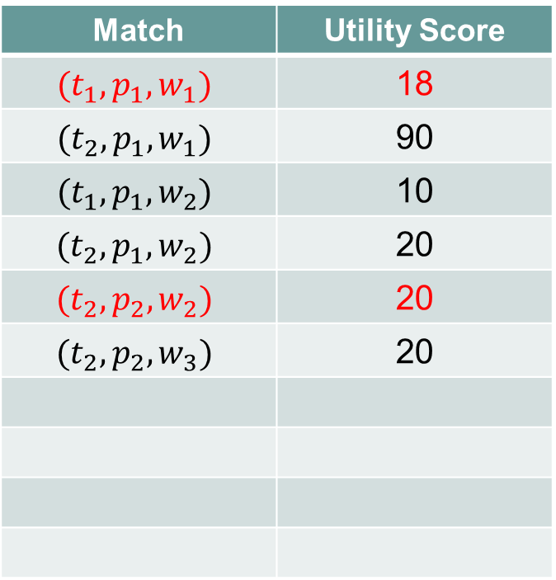
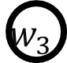
Greedy Algorithm
Basic idea
Match all triples when it is possible.
Match | Utility Score
$$(t_{1},p_{1},w_{1})$$ | 18
$$(t_{2},p_{1},w_{1})$$ | 90
$$(t_{1},p_{1},w_{2})$$ | 10
$$(t_{2},p_{1},w_{2})$$ | 20
$$(t_{2},p_{2},w_{2})$$ | 20
$$(t_{2},p_{2},w_{3})$$ | 20
$$t_{1}$$
$$p_{1}$$
$$w_{1}$$
$$t_{2}$$
$$p_{2}$$
$$w_{2}$$
$$w_{3}$$
Notes:
When t2 comes, no triple can be matched

Slide 40
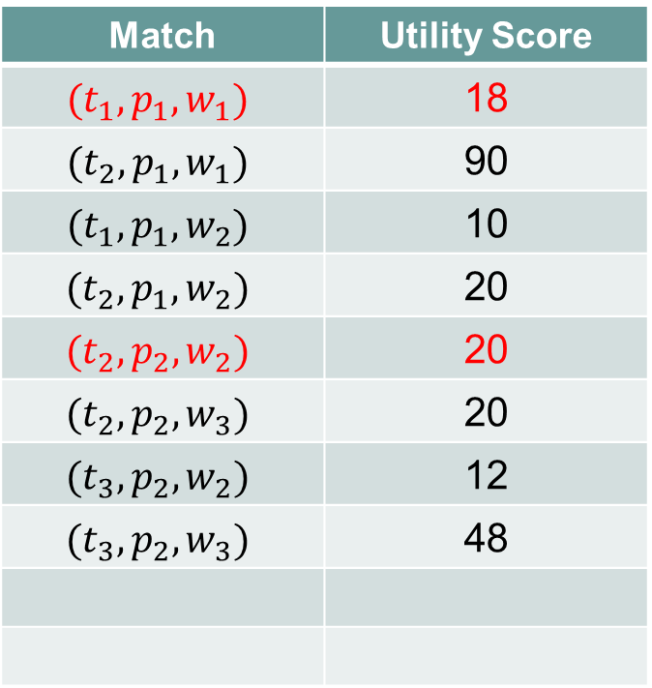

Greedy Algorithm
Basic idea
Match all triples when it is possible.
Match | Utility Score
$$(t_{1},p_{1},w_{1})$$ | 18
$$(t_{2},p_{1},w_{1})$$ | 90
$$(t_{1},p_{1},w_{2})$$ | 10
$$(t_{2},p_{1},w_{2})$$ | 20
$$(t_{2},p_{2},w_{2})$$ | 20
$$(t_{2},p_{2},w_{3})$$ | 20
$$(t_{3},p_{2},w_{2})$$ | 12
$$(t_{3},p_{2},w_{3})$$ | 48
$$t_{1}$$
$$p_{1}$$
$$w_{1}$$
$$t_{2}$$
$$p_{2}$$
$$w_{2}$$
$$t_{3}$$
$$w_{3}$$

Slide 41

Greedy Algorithm
Basic idea
Match all triples when it is possible.
Match | Utility Score
$$(t_{1},p_{1},w_{1})$$ | 18
$$(t_{2},p_{1},w_{1})$$ | 90
$$(t_{1},p_{1},w_{2})$$ | 10
$$(t_{2},p_{1},w_{2})$$ | 20
$$(t_{2},p_{2},w_{2})$$ | 20
$$(t_{2},p_{2},w_{3})$$ | 20
$$(t_{3},p_{2},w_{2})$$ | 12
$$(t_{3},p_{2},w_{3})$$ | 48
$$t_{1}$$
$$p_{1}$$
$$w_{1}$$
$$t_{2}$$
$$p_{2}$$
$$w_{2}$$
$$t_{3}$$
$$w_{3}$$
$$t_{4}$$

Slide 42
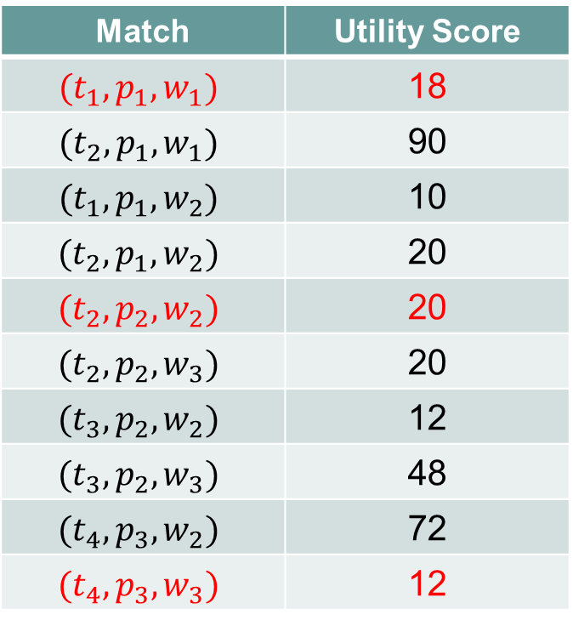
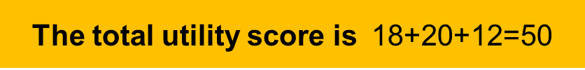


Greedy Algorithm
Basic idea
Match all triples when it is possible.
CR=$\frac{1}{3U_{max}}$
The total utility score is 18+20+12=50
Match | Utility Score
$$(t_{1},p_{1},w_{1})$$ | 18
$$(t_{2},p_{1},w_{1})$$ | 90
$$(t_{1},p_{1},w_{2})$$ | 10
$$(t_{2},p_{1},w_{2})$$ | 20
$$(t_{2},p_{2},w_{2})$$ | 20
$$(t_{2},p_{2},w_{3})$$ | 20
$$(t_{3},p_{2},w_{2})$$ | 12
$$(t_{3},p_{2},w_{3})$$ | 48
$$(t_{4},p_{3},w_{2})$$ | 72
$$(t_{4},p_{3},w_{3})$$ | 12
$$t_{1}$$
$$p_{1}$$
$$w_{1}$$
$$t_{2}$$
$$p_{2}$$
$$w_{2}$$
$$t_{3}$$
$$p_{3}$$
$$w_{3}$$
$$t_{4}$$

Slide 43
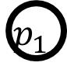

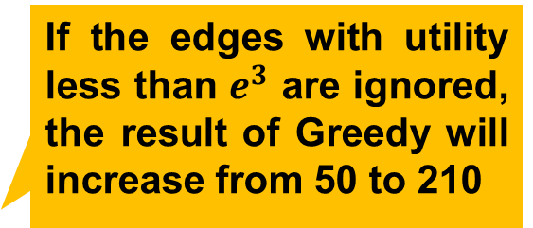
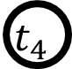


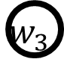
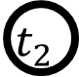
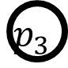

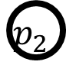
Basic-Threshold Algorithm
Why greedy may be bad?
Subsequent triples with large utility scores may be blocked
Our Strategy
Use a threshold to filter edges with low utility scores
How to set the threshold?
$$t_{1}$$
If the edges with utility less than $e^{3}$ are ignored, the result of Greedy will increase from 50 to 210
$$p_{1}$$
$$w_{1}$$
$$t_{2}$$
$$p_{2}$$
$$w_{2}$$
$$t_{3}$$
$$p_{3}$$
$$w_{3}$$
Some thresholds
$$t_{4}$$
Notes:
The Greedy algorithm is not satisfactory, subsequent triples with large utility scores may not be blocked
We then propose the Basic-Threshold algorithm, which is extended from the state-of-the-art algorithm, greedy-rt algorithm.
The basic idea is to first choose an integer k in the range of 0 to the formula randomly.
We then use e^k (e to the power of k) as a threshold and ignore all the edges with weights lower than the threshold.
We finally use a greedy strategy on the remaining edges.

Slide 44

Basic-Threshold Algorithm
Main idea
Choose an integer k from 0 to $\left\lceil \ln\left(U_{max}+1\right)\right\rceil −1$randomly.
Filter the edges with weights lower than $e^{k}.$
Use a greedy strategy on the remaining edges.
Notes:
The Greedy algorithm is not satisfactory, subsequent triples with large utility scores may not be blocked
We then propose the Basic-Threshold algorithm, which is extended from the state-of-the-art algorithm, greedy-rt algorithm.
The basic idea is to first choose an integer k in the range of 0 to the formula randomly.
We then use e^k (e to the power of k) as a threshold and ignore all the edges with weights lower than the threshold.
We finally use a greedy strategy on the remaining edges.

Slide 45
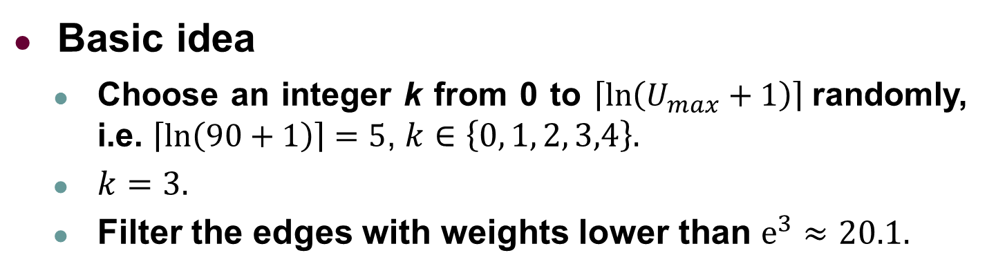
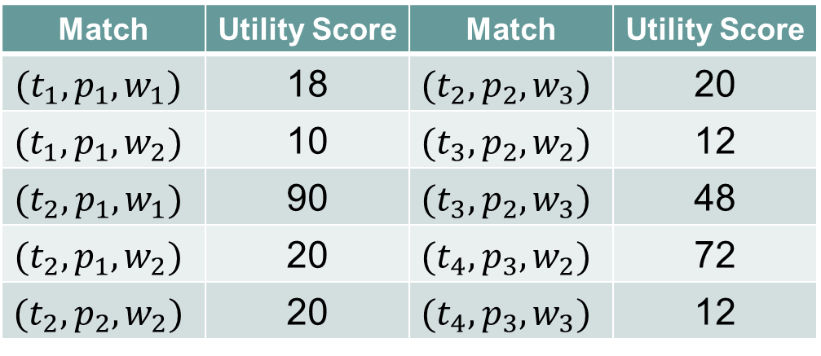
Basic-Threshold Algorithm
Basic idea
Choose an integer k from 0 to $\left\lceil \ln\left(U_{max}+1\right)\right\rceil$randomly, i.e. $\left\lceil \ln\left(90+1\right)\right\rceil =5$, $k∈\left\{0, 1, 2, 3,4\right\}.$
$k=3.$
Filter the edges with weights lower than $e^{3}≈20.1.$
Match | Utility Score | Match | Utility Score
$$(t_{1},p_{1},w_{1})$$ | 18 | $$(t_{2},p_{2},w_{3})$$ | 20
$$(t_{1},p_{1},w_{2})$$ | 10 | $$(t_{3},p_{2},w_{2})$$ | 12
$$(t_{2},p_{1},w_{1})$$ | 90 | $$(t_{3},p_{2},w_{3})$$ | 48
$$(t_{2},p_{1},w_{2})$$ | 20 | $$(t_{4},p_{3},w_{2})$$ | 72
$$(t_{2},p_{2},w_{2})$$ | 20 | $$(t_{4},p_{3},w_{3})$$ | 12
Notes:
加一个Bar
Here is a running example. Since the Umax is 90, we first sample the k as 3 and the threshold is 20.1.

Slide 46
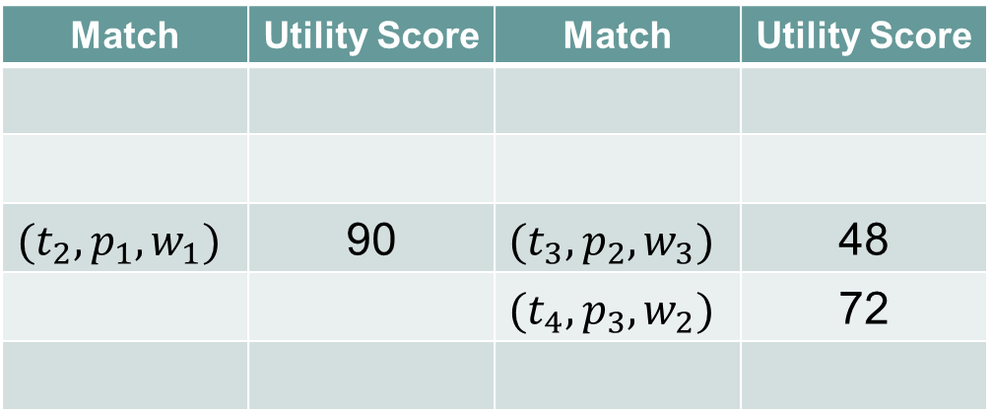
Basic-Threshold Algorithm
Basic idea
Choose an integer k from 0 to $\left\lceil \ln\left(U_{max}+1\right)\right\rceil$randomly, i.e. $\left\lceil \ln\left(90+1\right)\right\rceil =5$, $k∈\left\{0, 1, 2, 3,4\right\}.$
$k=3.$
Filter the edges with weights lower than $e^{3}≈20.1.$
Match | Utility Score | Match | Utility Score
$$(t_{2},p_{1},w_{1})$$ | 90 | $$(t_{3},p_{2},w_{3})$$ | 48
 |  | $$(t_{4},p_{3},w_{2})$$ | 72
Notes:
加一个Bar
Here is a running example. Since the Umax is 90, we first sample the k as 3 and the threshold is 20.1.

Slide 47



Basic-Threshold Algorithm
Basic idea
Filter the edges with weights lower than $e^{3}≈20.1.$
For each new arriving object, use a greedy strategy on the remaining edges.
Match | Utility Score
$$t_{1}$$
Notes:
We next adopt a greedy strategy to address the filtered edges.

Slide 48

Basic-Threshold Algorithm
Basic idea
Filter the edges with weights lower than $e^{3}≈20.1.$
For each new arriving object, use a greedy strategy on the remaining edges.
Match | Utility Score
$$t_{1}$$
$$p_{1}$$
Notes:
We next adopt a greedy strategy to address the filtered edges.

Slide 49



Basic-Threshold Algorithm
Basic idea
Filter the edges with weights lower than $e^{3}≈20.1.$
For each new arriving object, use a greedy strategy on the remaining edges.
Match | Utility Score
$$(t_{1},p_{1},w_{1})$$ | 18
$$t_{1}$$
$$p_{1}$$
$$w_{1}$$
The utility is less than the threshold
Notes:
We next adopt a greedy strategy to address the filtered edges.

Slide 50






Basic-Threshold Algorithm
Basic idea
Filter the edges with weights lower than $e^{3}≈20.1.$
For each new arriving object, use a greedy strategy on the remaining edges.
Match | Utility Score
$$(t_{1},p_{1},w_{1})$$ | 18
$$(t_{2},p_{1},w_{1})$$ | 90
$$t_{1}$$
$$t_{1}$$
$$p_{1}$$
$$p_{1}$$
$$w_{1}$$
$$w_{1}$$
$$t_{2}$$
$$t_{2}$$
Notes:
We next adopt a greedy strategy to address the filtered edges.

Slide 51


Basic-Threshold Algorithm
Basic idea
Filter the edges with weights lower than $e^{3}≈20.1.$
For each new arriving object, use a greedy strategy on the remaining edges.
Match | Utility Score
$$(t_{1},p_{1},w_{1})$$ | 18
$$(t_{2},p_{1},w_{1})$$ | 90
$$t_{1}$$
$$t_{1}$$
$$p_{1}$$
$$p_{1}$$
$$w_{1}$$
$$w_{1}$$
$$t_{2}$$
$$t_{2}$$
$$p_{2}$$
$$p_{2}$$
No triple
Notes:
We next adopt a greedy strategy to address the filtered edges.

Slide 52
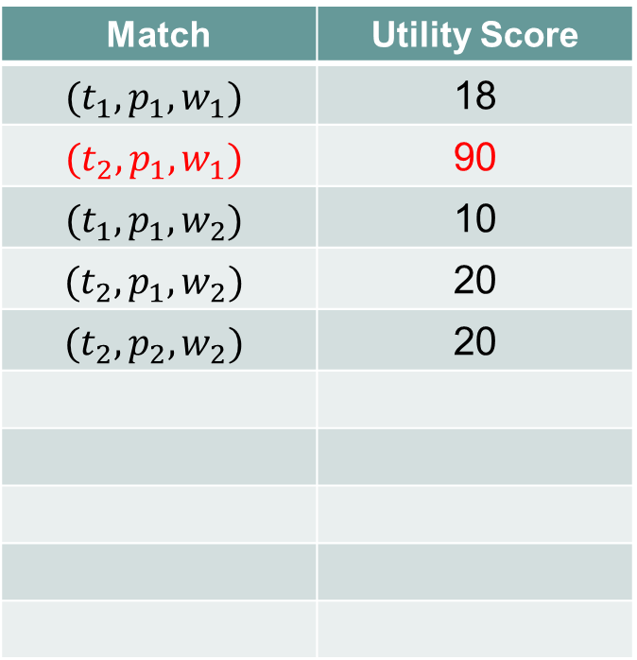


Basic-Threshold Algorithm
Basic idea
Filter the edges with weights lower than $e^{3}≈20.1.$
For each new arriving object, use a greedy strategy on the remaining edges.
Match | Utility Score
$$(t_{1},p_{1},w_{1})$$ | 18
$$(t_{2},p_{1},w_{1})$$ | 90
$$(t_{1},p_{1},w_{2})$$ | 10
$$(t_{2},p_{1},w_{2})$$ | 20
$$(t_{2},p_{2},w_{2})$$ | 20
$$t_{1}$$
$$t_{1}$$
$$p_{1}$$
$$p_{1}$$
$$w_{1}$$
$$w_{1}$$
$$t_{2}$$
$$t_{2}$$
$$p_{2}$$
$$p_{2}$$
$$w_{2}$$
$$w_{2}$$
p1 and t2 have been occupied
Notes:
We next adopt a greedy strategy to address the filtered edges.

Slide 53



Basic-Threshold Algorithm
Basic idea
Filter the edges with weights lower than $e^{3}≈20.1.$
For each new arriving object, use a greedy strategy on the remaining edges.
Match | Utility Score
$$(t_{1},p_{1},w_{1})$$ | 18
$$(t_{2},p_{1},w_{1})$$ | 90
$$(t_{1},p_{1},w_{2})$$ | 10
$$(t_{2},p_{1},w_{2})$$ | 20
$$(t_{2},p_{2},w_{2})$$ | 20
$$(t_{2},p_{2},w_{3})$$ | 20
$$t_{1}$$
$$t_{1}$$
$$p_{1}$$
$$p_{1}$$
$$w_{1}$$
$$w_{1}$$
$$t_{2}$$
$$t_{2}$$
$$p_{2}$$
$$p_{2}$$
$$w_{2}$$
$$w_{2}$$
$$w_{3}$$
$$w_{3}$$
t2 has been occupied
Notes:
We next adopt a greedy strategy to address the filtered edges.

Slide 54



Basic-Threshold Algorithm
Basic idea
Filter the edges with weights lower than $e^{3}≈20.1.$
For each new arriving object, use a greedy strategy on the remaining edges.
Match | Utility Score
$$(t_{1},p_{1},w_{1})$$ | 18
$$(t_{2},p_{1},w_{1})$$ | 90
$$(t_{1},p_{1},w_{2})$$ | 10
$$(t_{2},p_{1},w_{2})$$ | 20
$$(t_{2},p_{2},w_{2})$$ | 20
$$(t_{2},p_{2},w_{3})$$ | 20
$$(t_{3},p_{2},w_{2})$$ | 12
$$(t_{3},p_{2},w_{3})$$ | 48
$$t_{1}$$
$$t_{1}$$
$$p_{1}$$
$$p_{1}$$
$$w_{1}$$
$$w_{1}$$
$$t_{2}$$
$$t_{2}$$
$$p_{2}$$
$$p_{2}$$
$$w_{2}$$
$$w_{2}$$
$$t_{3}$$
$$t_{3}$$
$$w_{3}$$
$$w_{3}$$
The triple of (t3, p2, w2) is filtered by the threshold.
Notes:
We next adopt a greedy strategy to address the filtered edges.

Slide 55


Basic-Threshold Algorithm
Basic idea
Filter the edges with weights lower than $e^{3}≈20.1.$
For each new arriving object, use a greedy strategy on the remaining edges.
Match | Utility Score
$$(t_{1},p_{1},w_{1})$$ | 18
$$(t_{2},p_{1},w_{1})$$ | 90
$$(t_{1},p_{1},w_{2})$$ | 10
$$(t_{2},p_{1},w_{2})$$ | 20
$$(t_{2},p_{2},w_{2})$$ | 20
$$(t_{2},p_{2},w_{3})$$ | 20
$$(t_{3},p_{2},w_{2})$$ | 12
$$(t_{3},p_{2},w_{3})$$ | 48
$$t_{1}$$
$$t_{1}$$
$$p_{1}$$
$$p_{1}$$
$$w_{1}$$
$$w_{1}$$
$$t_{2}$$
$$t_{2}$$
$$p_{2}$$
$$p_{2}$$
$$w_{2}$$
$$w_{2}$$
$$t_{3}$$
$$t_{3}$$
$$w_{3}$$
$$w_{3}$$
$$t_{4}$$
$$t_{4}$$
Notes:
We next adopt a greedy strategy to address the filtered edges.

Slide 56




Basic-Threshold Algorithm
For all possible values of k, the expectation of total utility is (50+50+50+210+162)/5=104.4
Basic idea
Filter the edges with weights lower than $e^{3}≈20.1.$
For each new arriving object, use a greedy strategy on the remaining edges.
Match | Utility Score
$$(t_{1},p_{1},w_{1})$$ | 18
$$(t_{2},p_{1},w_{1})$$ | 90
$$(t_{1},p_{1},w_{2})$$ | 10
$$(t_{2},p_{1},w_{2})$$ | 20
$$(t_{2},p_{2},w_{2})$$ | 20
$$(t_{2},p_{2},w_{3})$$ | 20
$$(t_{3},p_{2},w_{2})$$ | 12
$$(t_{3},p_{2},w_{3})$$ | 48
$$(t_{4},p_{3},w_{2})$$ | 72
$$(t_{4},p_{3},w_{3})$$ | 12
$$t_{1}$$
$$t_{1}$$
$$p_{1}$$
$$p_{1}$$
$$w_{1}$$
$$w_{1}$$
$$t_{2}$$
$$t_{2}$$
$$p_{2}$$
$$p_{2}$$
$$w_{2}$$
$$w_{2}$$
$$t_{3}$$
$$t_{3}$$
$$p_{3}$$
$$p_{3}$$
$$w_{3}$$
$$w_{3}$$
$$t_{4}$$
$$t_{4}$$
CR = $\frac{1}{3eln(1+U_{max})}$
Notes:
We next adopt a greedy strategy to address the filtered edges.

Slide 57

Adaptive-Threshold Algorithm
What drawbacks does Basic-Threshold have?
Different thresholds have significant influence on the matching results.
If an improper threshold is chosen, the algorithm performs bad finally.
Improper thresholds
Optimal/best threshold
Threshold | e⁰ | e¹ | e² | e³ | e⁴
Utility | 50 | 50 | 50 | 210 | 162
Suboptimal threshold
What if we choose a new threshold according to the partial information that has been gained once a new object appears.
The chosen threshold will be used through the whole procedure.
Notes:
We further improve the Basic-Threshold algorithm to the Adaptive-Threshold algorithm
The basic idea is that…

Slide 58
Adaptive-Threshold Algorithm
What drawbacks does Basic-Threshold have?
Different thresholds have significant influence on the matching results.
If an improper threshold is chosen, the algorithm performs bad finally.
Our Strategy
Once a new object appears, we adaptively choose a proper threshold.
Adaptively adjust the probability distribution of choosing different thresholds according to the partial information that has been gained
Notes:
We further improve the Basic-Threshold algorithm to the Adaptive-Threshold algorithm
The basic idea is that…

Slide 59


Adaptive-Threshold Algorithm
Threshold | e⁰ | e¹ | e² | e³ | e⁴
$$t_{1}$$ | 1 | 1 | 1 | 1 | 1
$$t_{1}$$
Initially, all the thresholds have weight of 1, and the probability to choose any threshold is 1/(1+1+1+1+1)=1/5=0.2

Slide 60


Adaptive-Threshold Algorithm
Threshold | e⁰ | e¹ | e² | e³ | e⁴
$$t_{1}$$ | 1 | 1 | 1 | 1 | 1
$$p_{1}$$ | 1 | 1 | 1 | 1 | 1
$$t_{1}$$
$$p_{1}$$
When p1 appears, as no triple is matched using any threshold, the weights keep unchanged.

Slide 61



Adaptive-Threshold Algorithm
Threshold | e⁰ | e¹ | e² | e³ | e⁴
$$t_{1}$$ | 1 | 1 | 1 | 1 | 1
$$p_{1}$$ | 1 | 1 | 1 | 1 | 1
$$t_{1}$$
$$p_{1}$$
$$w_{1}$$
When w1 appears, we first choose a new threshold according to the probability distribution. Suppose e² is chosen.

Slide 62


Adaptive-Threshold Algorithm
Threshold | e⁰ | e¹ | e² | e³ | e⁴
$$t_{1}$$ | 1 | 1 | 1 | 1 | 1
$$p_{1}$$ | 1 | 1 | 1 | 1 | 1
$$t_{1}$$
$$p_{1}$$
$$w_{1}$$
When w1 appears, we first choose a new threshold according to the probability distribution. Suppose e² is chosen.
If using the first three thresholds from the beginning, utility of 18 will be gained
$$w=w\left(1+ηu\right)=1×(1+0.001×18)≈1.02$$
$η=0.001$ in this example

Slide 63

Adaptive-Threshold Algorithm
Threshold | e⁰ | e¹ | e² | e³ | e⁴
$$t_{1}$$ | 1 | 1 | 1 | 1 | 1
$$p_{1}$$ | 1 | 1 | 1 | 1 | 1
$$w_{1}$$ | 1.02 | 1.02 | 1.02 | 1 | 1
$$t_{1}$$
$$p_{1}$$
$$w_{1}$$
When w1 appears, we first choose a new threshold according to the probability distribution. Suppose e² is chosen.
If using the first three thresholds from the beginning, utility of 18 will be gained
$$w=w\left(1+ηu\right)=1×(1+0.001×18)≈1.02$$
$η=0.001$ in this example
Notes:
加上文本框

Slide 64



Adaptive-Threshold Algorithm
Threshold | e⁰ | e¹ | e² | e³ | e⁴
$$t_{1}$$ | 1 | 1 | 1 | 1 | 1
$$p_{1}$$ | 1 | 1 | 1 | 1 | 1
$$w_{1}$$ | 1.02 | 1.02 | 1.02 | 1 | 1
$$t_{2}$$ | 1.02 | 1.02 | 1.02 | 1.09 | 1.09
$$t_{1}$$
$$p_{1}$$
$$w_{1}$$
$$t_{2}$$
When t2 appears, if using the last two thresholds from the beginning, utility of 90 will be gained
$$w=w\left(1+ηu\right)=1×(1+0.001×90)=1.09$$

Slide 65


Adaptive-Threshold Algorithm
Threshold | e⁰ | e¹ | e² | e³ | e⁴
$$t_{1}$$ | 1 | 1 | 1 | 1 | 1
$$p_{1}$$ | 1 | 1 | 1 | 1 | 1
$$w_{1}$$ | 1.02 | 1.02 | 1.02 | 1 | 1
$$t_{2}$$ | 1.02 | 1.02 | 1.02 | 1.09 | 1.09
$$p_{2}$$ | 1.02 | 1.02 | 1.02 | 1.09 | 1.09
$$t_{1}$$
$$p_{1}$$
$$w_{1}$$
$$t_{2}$$
$$p_{2}$$
When p2 appears, as no triple is matched using any threshold, the weights keep unchanged.

Slide 66


Adaptive-Threshold Algorithm
Threshold | e⁰ | e¹ | e² | e³ | e⁴
$$t_{1}$$ | 1 | 1 | 1 | 1 | 1
$$p_{1}$$ | 1 | 1 | 1 | 1 | 1
$$w_{1}$$ | 1.02 | 1.02 | 1.02 | 1 | 1
$$t_{2}$$ | 1.02 | 1.02 | 1.02 | 1.09 | 1.09
$$p_{2}$$ | 1.02 | 1.02 | 1.02 | 1.09 | 1.09
$$t_{1}$$
$$p_{1}$$
$$w_{1}$$
$$t_{2}$$
$$p_{2}$$
$$w_{2}$$
When w2 appears, we first choose a new threshold according to the probability distribution. Suppose e⁴ is chosen, (t2, p2, w2) will not be matched
If using the first three thresholds from the beginning, utility of 20 will be gained
$$w=w\left(1+ηu\right)=1.02×(1+0.001×20)≈1.04$$

Slide 67


Adaptive-Threshold Algorithm
Threshold | e⁰ | e¹ | e² | e³ | e⁴
$$t_{1}$$ | 1 | 1 | 1 | 1 | 1
$$p_{1}$$ | 1 | 1 | 1 | 1 | 1
$$w_{1}$$ | 1.02 | 1.02 | 1.02 | 1 | 1
$$t_{2}$$ | 1.02 | 1.02 | 1.02 | 1.09 | 1.09
$$p_{2}$$ | 1.02 | 1.02 | 1.02 | 1.09 | 1.09
$$w_{2}$$ | 1.04 | 1.04 | 1.04 | 1.09 | 1.09
$$t_{1}$$
$$p_{1}$$
$$w_{1}$$
$$t_{2}$$
$$p_{2}$$
$$w_{2}$$
When w2 appears, we first choose a new threshold according to the probability distribution. Suppose e⁴ is chosen, (t2, p2, w2) will not be matched
If using the first three thresholds from the beginning, utility of 20 will be gained
$$w=w\left(1+ηu\right)=1.02×(1+0.001×20)≈1.04$$

Slide 68


Adaptive-Threshold Algorithm
Threshold | e⁰ | e¹ | e² | e³ | e⁴
$$t_{1}$$ | 1 | 1 | 1 | 1 | 1
$$p_{1}$$ | 1 | 1 | 1 | 1 | 1
$$w_{1}$$ | 1.02 | 1.02 | 1.02 | 1 | 1
$$t_{2}$$ | 1.02 | 1.02 | 1.02 | 1.09 | 1.09
$$p_{2}$$ | 1.02 | 1.02 | 1.02 | 1.09 | 1.09
$$w_{2}$$ | 1.04 | 1.04 | 1.04 | 1.09 | 1.09
$$w_{3}$$ | 1.04 | 1.04 | 1.04 | 1.09 | 1.09
$$t_{1}$$
$$p_{1}$$
$$w_{1}$$
$$t_{2}$$
$$p_{2}$$
$$w_{2}$$
$$w_{3}$$
When w3 appears, as no triple is matched using any threshold from the beginning, the weights keep unchanged.

Slide 69

Adaptive-Threshold Algorithm
Threshold | e⁰ | e¹ | e² | e³ | e⁴
$$t_{1}$$ | 1 | 1 | 1 | 1 | 1
$$p_{1}$$ | 1 | 1 | 1 | 1 | 1
$$w_{1}$$ | 1.02 | 1.02 | 1.02 | 1 | 1
$$t_{2}$$ | 1.02 | 1.02 | 1.02 | 1.09 | 1.09
$$p_{2}$$ | 1.02 | 1.02 | 1.02 | 1.09 | 1.09
$$w_{2}$$ | 1.04 | 1.04 | 1.04 | 1.09 | 1.09
$$w_{3}$$ | 1.04 | 1.04 | 1.04 | 1.09 | 1.09
$$t_{1}$$
$$p_{1}$$
$$w_{1}$$
$$t_{2}$$
$$p_{2}$$
$$w_{2}$$
$$t_{3}$$
$$w_{3}$$
When t3 appears, we first choose a new threshold according the probability distribution. Suppose e³ is chosen, (t3, p2, w3) will be matched.
If using the threshold of e³ from the beginning, utility of 48 will be gained

Slide 70

Adaptive-Threshold Algorithm
Threshold | e⁰ | e¹ | e² | e³ | e⁴
$$t_{1}$$ | 1 | 1 | 1 | 1 | 1
$$p_{1}$$ | 1 | 1 | 1 | 1 | 1
$$w_{1}$$ | 1.02 | 1.02 | 1.02 | 1 | 1
$$t_{2}$$ | 1.02 | 1.02 | 1.02 | 1.09 | 1.09
$$p_{2}$$ | 1.02 | 1.02 | 1.02 | 1.09 | 1.09
$$w_{2}$$ | 1.04 | 1.04 | 1.04 | 1.09 | 1.09
$$w_{3}$$ | 1.04 | 1.04 | 1.04 | 1.09 | 1.09
$$t_{3}$$ | 1.04 | 1.04 | 1.04 | 1.14 | 1.09
$$t_{1}$$
$$p_{1}$$
$$w_{1}$$
$$t_{2}$$
$$p_{2}$$
$$w_{2}$$
$$t_{3}$$
$$w_{3}$$
When t3 appears, we first choose a new threshold according the probability distribution. Suppose e³ is chosen, (t3, p2, w3) will be matched.
If using the threshold of e³ from the beginning, utility of 48 will be gained

Slide 71


Adaptive-Threshold Algorithm
Threshold | e⁰ | e¹ | e² | e³ | e⁴
$$t_{1}$$ | 1 | 1 | 1 | 1 | 1
$$p_{1}$$ | 1 | 1 | 1 | 1 | 1
$$w_{1}$$ | 1.02 | 1.02 | 1.02 | 1 | 1
$$t_{2}$$ | 1.02 | 1.02 | 1.02 | 1.09 | 1.09
$$p_{2}$$ | 1.02 | 1.02 | 1.02 | 1.09 | 1.09
$$w_{2}$$ | 1.04 | 1.04 | 1.04 | 1.09 | 1.09
$$w_{3}$$ | 1.04 | 1.04 | 1.04 | 1.09 | 1.09
$$t_{3}$$ | 1.04 | 1.04 | 1.04 | 1.14 | 1.09
$$t_{4}$$ | 1.04 | 1.04 | 1.04 | 1.14 | 1.09
$$t_{1}$$
$$p_{1}$$
$$w_{1}$$
$$t_{2}$$
$$p_{2}$$
$$w_{2}$$
$$t_{3}$$
$$w_{3}$$
$$t_{4}$$
When t4 appears, all weights keep unchanged.

Slide 72

Adaptive-Threshold Algorithm
Threshold | e⁰ | e¹ | e² | e³ | e⁴
$$t_{1}$$ | 1 | 1 | 1 | 1 | 1
$$p_{1}$$ | 1 | 1 | 1 | 1 | 1
$$w_{1}$$ | 1.02 | 1.02 | 1.02 | 1 | 1
$$t_{2}$$ | 1.02 | 1.02 | 1.02 | 1.09 | 1.09
$$p_{2}$$ | 1.02 | 1.02 | 1.02 | 1.09 | 1.09
$$w_{2}$$ | 1.04 | 1.04 | 1.04 | 1.09 | 1.09
$$w_{3}$$ | 1.04 | 1.04 | 1.04 | 1.09 | 1.09
$$t_{3}$$ | 1.04 | 1.04 | 1.04 | 1.14 | 1.09
$$t_{4}$$ | 1.04 | 1.04 | 1.04 | 1.14 | 1.09
$$t_{1}$$
$$p_{1}$$
$$w_{1}$$
$$t_{2}$$
$$p_{2}$$
$$w_{2}$$
$$t_{3}$$
$$p_{3}$$
$$w_{3}$$
$$t_{4}$$
When t3 appears, suppose e³ is chosen, (t4, p3, w2) will be matched.
In this example, the total utility is 138.
Notes:
Adaptive-Threshold can always
achieve nearly the best possible performance of Basic-
Threshold with different thresholds in hindsight

Slide 73

Adaptive-Threshold Algorithm
Threshold | e⁰ | e¹ | e² | e³ | e⁴
$$t_{1}$$ | 1 | 1 | 1 | 1 | 1
$$p_{1}$$ | 1 | 1 | 1 | 1 | 1
$$w_{1}$$ | 1.02 | 1.02 | 1.02 | 1 | 1
$$t_{2}$$ | 1.02 | 1.02 | 1.02 | 1.09 | 1.09
$$p_{2}$$ | 1.02 | 1.02 | 1.02 | 1.09 | 1.09
$$w_{2}$$ | 1.04 | 1.04 | 1.04 | 1.09 | 1.09
$$w_{3}$$ | 1.04 | 1.04 | 1.04 | 1.09 | 1.09
$$t_{3}$$ | 1.04 | 1.04 | 1.04 | 1.14 | 1.09
$$t_{4}$$ | 1.04 | 1.04 | 1.04 | 1.14 | 1.09
$$p_{3}$$ | 1.05 | 1.05 | 1.05 | 1.22 | 1.17
$$t_{1}$$
$$p_{1}$$
$$w_{1}$$
$$t_{2}$$
$$p_{2}$$
$$w_{2}$$
$$t_{3}$$
$$p_{3}$$
$$w_{3}$$
$$t_{4}$$
When t3 appears, suppose e³ is chosen, (t4, p3, w2) will be matched.
In this example, the total utility is 138.
Notes:
Adaptive-Threshold can always
achieve nearly the best possible performance of Basic-
Threshold with different thresholds in hindsight

Slide 74


Adaptive-Threshold Algorithm
Threshold | e⁰ | e¹ | e² | e³ | e⁴
$$t_{1}$$ | 1 | 1 | 1 | 1 | 1
$$p_{1}$$ | 1 | 1 | 1 | 1 | 1
$$w_{1}$$ | 1.02 | 1.02 | 1.02 | 1 | 1
$$t_{2}$$ | 1.02 | 1.02 | 1.02 | 1.09 | 1.09
$$p_{2}$$ | 1.02 | 1.02 | 1.02 | 1.09 | 1.09
$$w_{2}$$ | 1.04 | 1.04 | 1.04 | 1.09 | 1.09
$$w_{3}$$ | 1.04 | 1.04 | 1.04 | 1.09 | 1.09
$$t_{3}$$ | 1.04 | 1.04 | 1.04 | 1.14 | 1.09
$$t_{4}$$ | 1.04 | 1.04 | 1.04 | 1.14 | 1.09
$$p_{3}$$ | 1.05 | 1.05 | 1.05 | 1.22 | 1.17
$$t_{1}$$
$$p_{1}$$
$$w_{1}$$
$$t_{2}$$
Adaptive-Threshold can always achieve nearly the best possible performance of Basic- Threshold with different thresholds in hindsight.
$$p_{2}$$
$$w_{2}$$
$$t_{3}$$
$$p_{3}$$
$$w_{3}$$
$$t_{4}$$
The best performance that Basic-Threshold may have when considering all possible thresholds.
$$𝔼[MaxSum]≥\left(1−ε\right)MaxSum\left({OPT}_{Basic−Threshold}\right)−\frac{ε\left(1−ε\right)}{2D}\sum_{v}{{\left(g_{v}^{∗}\right)}^{2}−}\frac{D \left(1−ε\right)}{ε}ln⁡(θ)$$
Notes:
Adaptive-Threshold can always
achieve nearly the best possible performance of Basic-
Threshold with different thresholds in hindsight

Slide 75
Why this metric?
The motivation of the Adaptive-Threshold algorithm is to address the unstable performance of Basic-Threshold. Thus, the performance is compared with the best performance that Basic-Threshold may have in hindsight.

Slide 76
Outline
Background and Motivation
Problem Statement
Our Solutions
Experiments
Conclusion
Notes:
We then show some experimental results.

Slide 77


Experimental Setting
Synthetic Datasets
|T|: The number of spatial tasks.
|W|: The number of crowd workers.
|P|: The number of work places.
$μ(λ^{−1})$: The parameters of positions/utility when following Normal(Exponential) distributions.
$r_{w}\text{: }\text{The} \text{range} \text{radius} \text{of} \text{crowd} \text{workers}$.
Waiting Time: The Waiting time of tasks/workers.
Real Datasets
SportsCompany
|T|=856, |W|=508, |P|=179
gMission
|T|=630, |W|=576, |P|=427
Compared Algorithms
Random, Greedy, Basic-Threshold, Adaptive-Threshold
Notes:
We use two real datasets and a larger synthetic dataset and compare the three proposed algorithms.
Random is a baseline which matches the objects randomly.

Slide 78


Experiments: Vary |T| & Scalability
Adaptive-Threshold is the most effective.
Although Adaptive-Threshold consumes the longest time, it is still efficient enough as it can process an object in less than 1 millisecond on average.
Notes:
图详细讲一下

Slide 79

Experiments: Real Data
The waiting time of tasks, workers and places.
Notes:
Here are the results on real datasets.
With increasing the waiting time, we can again observe that Adaptive-Threshold is the most effective.

Slide 80
Experiments: Real Data
gMission
SportsCompany
The product of task’s reward and worker’s success ratio is used as the utility of a triple
The utility of a triple is the sum of the price of the trainer and the sports venue.
Notes:
The data of tasks and workers a from gMission and the data of places are POIs and the start and leaving time are generated.

Slide 81
Outline
Background and Motivation
Problem Statement
Our Solutions
Experiments
Conclusion
Notes:
We finally conclude our work.

Slide 82
Conclusion
Formally define a novel dynamic task assignment problem, called the trichromatic online matching in real-time spatial crowdsourcing (TOM) problem.
Design two threshold-based algorithms with theoretical guarantees.
Extensive experiments on both real and synthetic datasets to verify our solutions.
Notes:
We formally define novel dynamic task assignment problem for crowdsourcing.
We design two threshold-based algorithms with theoretical guarantees.
And we run extensive experiments on both real and synthetic datasets to verify our proposed solutions.

Slide 83

Thank You
Q & A

Slide 84
Extend to more dimensions?
Our framework can work for four or more types of objects, and similar theoretical guarantees can be achieved. We plan to interpret this point in our Journal version in the future.

